Slide 1

Who I am
By : Jacob Mullins

Slide 2

About Me
24 years old
Full Time Student
Gamer
Information Technology Enthusiast
Astronomy Enthusiast

Slide 3
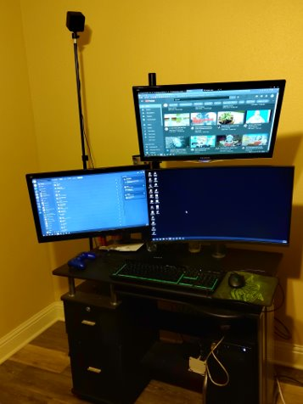
Gaming
PC
PC Specs
intel(R) Core ™ i5-9600k CPU
16 GB RAM
NVIDIA GeForce GTX 1660 Ti
ASUS PRIME 2370-A LGA 1151 (300 Series) ATX Motherboard
Corsair 500w Power Supply
500GB SSD, 500GB HDD, 2TB external HDD
Switch

Slide 4

Full Time Student
Attending ITI College
Associates in IT
Planning of specializing in Network
Perfect Attendance

Slide 5

Goals
Graduating ITI
A job that pays well and I enjoy

